Slide 1



Machine Learning
S. Sridhar and M. Vijayalakshmi

Slide 2
Chapter 2
Understanding of Data

Slide 3
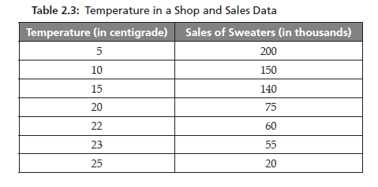
Bivariate Data
Bivariate data means data involving two variables measured together, to study the relationship between them.INVOLVES TWO VARIABLES

Slide 4
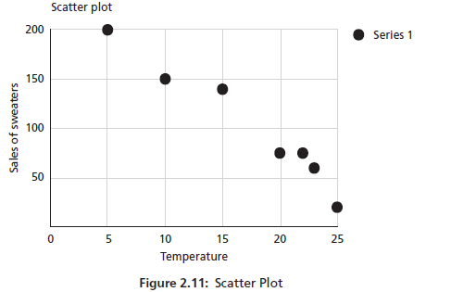
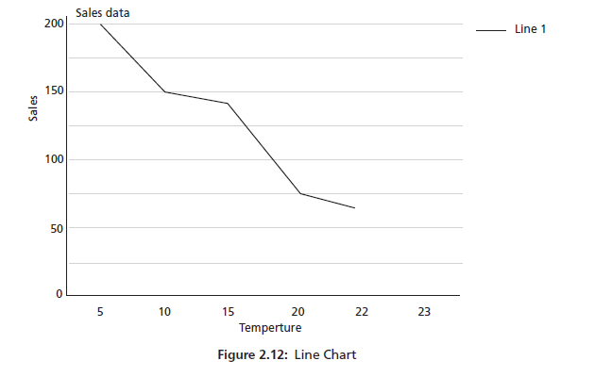
Bivariate Data Visualization
It shows two common visualization techniques:
Scatter Plot
Line Chart
Both are used for bivariate data (Temperature vs Sales).

Slide 5

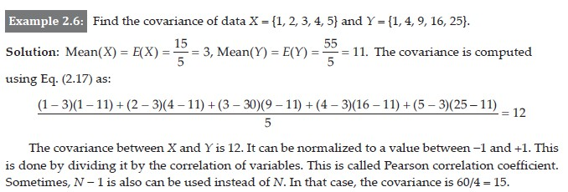
Bivariate Data – Covariance
Covariance tells us:
Direction of relationship between two variables
Whether they increase together or move in opposite directions

Slide 6
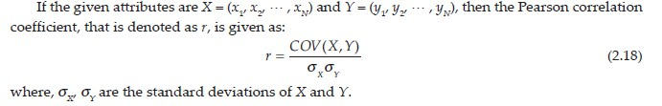
Bivariate Data – Correlation

Slide 7
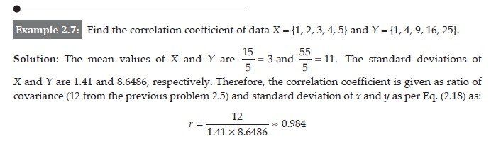
Bivariate Data – Correlation

Slide 8
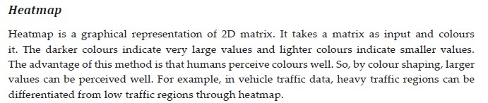
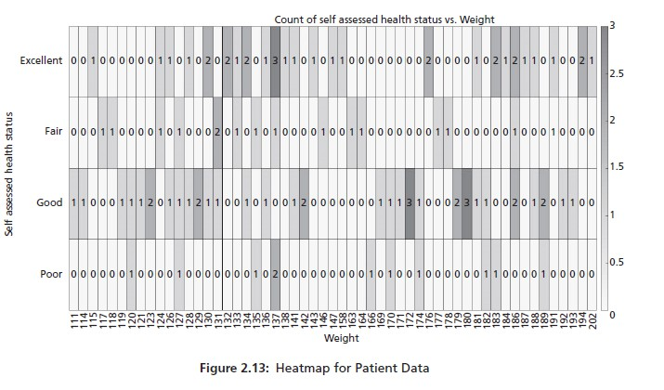
Multivariate Data Visualization
Multivariate data involves three or more variables measured for each observation.
A heatmap is a graphical representation of a data matrix using colors.
Rows → one variable or category
Columns → another variable or time
Color intensity → value magnitude
Analysis
Darker colors = higher values
Lighter colors = lower values

Slide 9
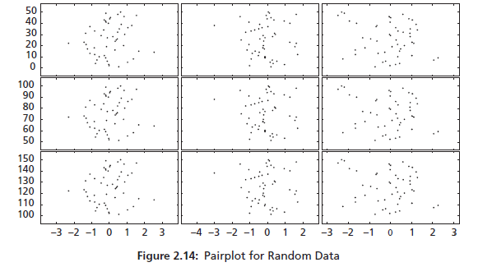
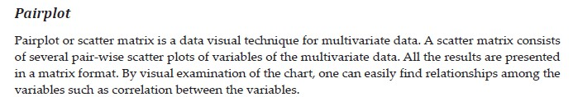
Multivariate Data Visualization
A pairplot (also called a scatter plot matrix) shows:
Pairwise relationships between multiple variables
Arranged in a matrix format
Each small graph represents the relationship between two variables at a time.

Slide 10
Why pairplot is useful?
Quickly compares many variables at once
Helps identify:
Correlation (positive/negative)
Clusters
Outliers
Redundant variables
Pairplot is a multivariate data visualization technique that displays pairwise scatter plots of variables in a matrix form.
Pairplot allows us to compare every variable with every other variable in one view.

Slide 11
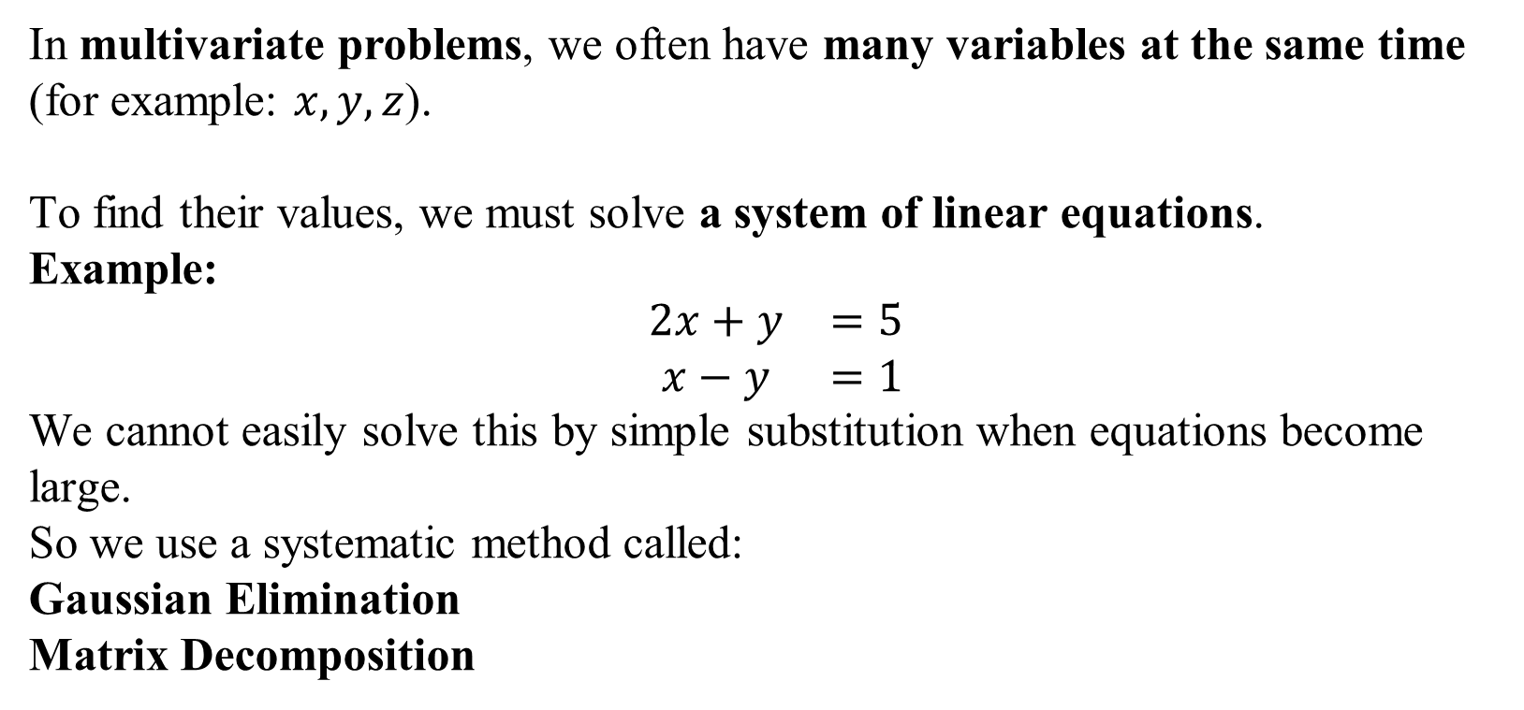
Multivariate Essential Mathematics
In multivariate problems, we often have many variables at the same time
(for example: $x,y,z$).
To find their values, we must solve a system of linear equations.
Example:
$$\begin{matrix}2x+y & =5 \\ x−y & =1\end{matrix}$$
We cannot easily solve this by simple substitution when equations become large.
So we use a systematic method called:
Gaussian Elimination
Matrix Decomposition

Slide 12
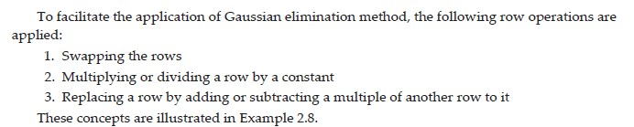
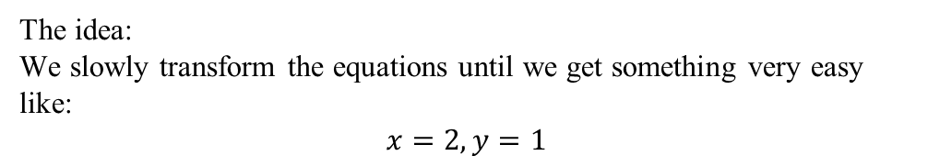
Multivariate Essential Mathematics
1. GAUSSIAN ELIMINATION:- Gaussian Elimination is a step-by-step method used to solve multiple linear equations by converting them into a simpler form.
The idea:
We slowly transform the equations until we get something very easy like:
$$x=2, y=1$$

Slide 13
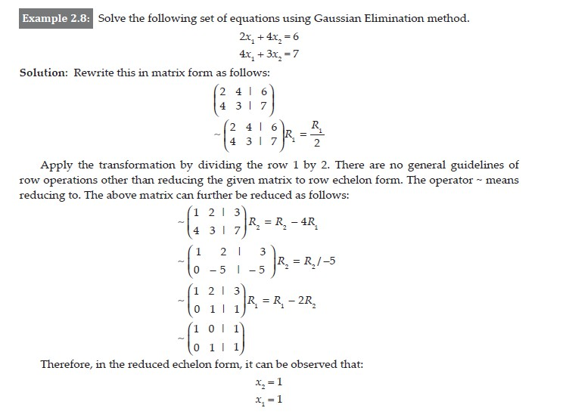
Multivariate Essential Mathematics
GAUSSIAN ELIMINATION

Slide 14
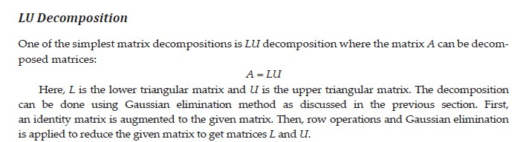
Multivariate Essential Mathematics
2. MATRIX DECOMPOSITION:- After Gaussian Elimination, the next concept is Matrix Decomposition.
In multivariate mathematics (and Machine Learning), instead of solving equations again and again, we break a complex matrix into simpler matrices. This process is called: Matrix Decomposition
Matrix decomposition means splitting a matrix into smaller, easier matrices so calculations become faster and simpler.

Slide 15
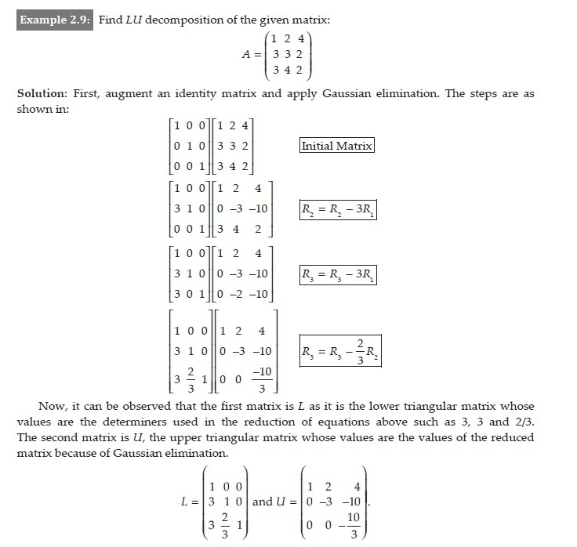
Multivariate Essential Mathematics
MATRIX DECOMPOSITION
Because while we perform Gaussian elimination on A, the operations performed are stored in the identity matrix.
That stored information becomes L, and the simplified matrix becomes U.
In LU decomposition, Gaussian elimination is applied to a matrix A to convert it into an upper triangular matrix U, while the elimination factors form the lower triangular matrix L such that A = LU.

Slide 16

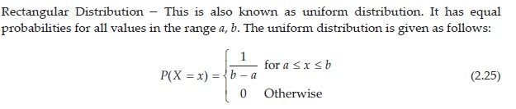
Multivariate Essential Mathematics
1. Distribution :- which describe how values of a random variable are spread.
A distribution tells us:
What values a variable can take
How likely each value is
Distributions are the foundation of statistics, ML, and data analysis.

Slide 17

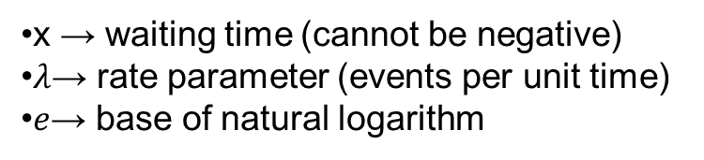
Multivariate Essential Mathematics
Exponential Distribution, a continuous probability distribution commonly used to model waiting time or time until an event occurs.
The Exponential distribution describes:
Time between events
Events that occur randomly and independently at a constant rate
probability density function (PDF)
It is widely used in:
Reliability engineering
Network traffic
Queueing systems
Machine learning (event modeling)
x → waiting time (cannot be negative)
$λ$→ rate parameter (events per unit time)
$e$→ base of natural logarithm

Slide 18
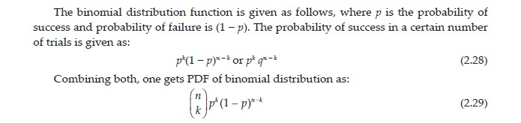
Multivariate Essential Mathematics
BINOMIAL DISTRIBUTION

Slide 19
Multivariate Essential Mathematics
POISSON AND BERNOULLI DISTRIBUTION
BERNOULLI DISTRIBUTION
This is the simplest probability distribution.
A Bernoulli distribution models an experiment that has only two possible outcomes.
Possible outcomes
Success (1)
Failure (0)
Examples:
Coin toss → Head or Tail
Student pass/fail
Email → spam or not spam
Light bulb → working or not working
Where used in ML?
Binary classification
Spam detection
Disease prediction (infected/not infected)
Pass/fail prediction
👉 Logistic Regression is based on Bernoulli probability.

Slide 20
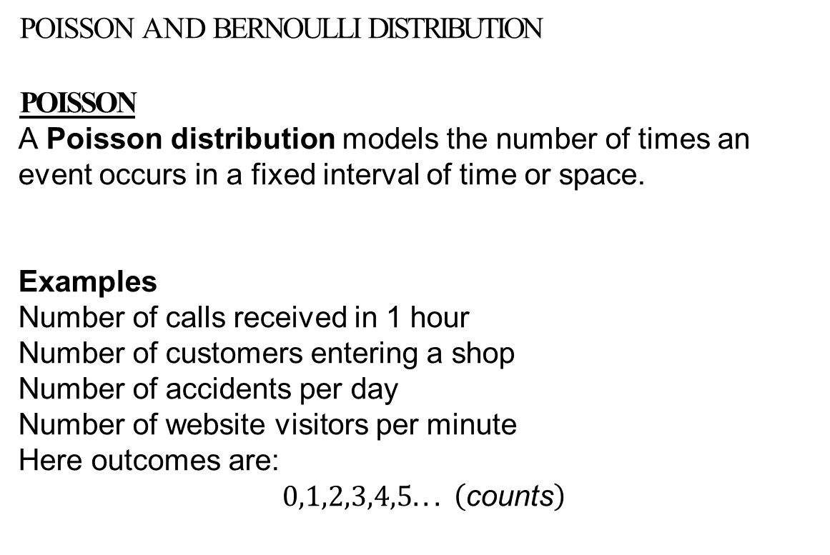
Multivariate Essential Mathematics
POISSON AND BERNOULLI DISTRIBUTION
POISSON
A Poisson distribution models the number of times an event occurs in a fixed interval of time or space.
Examples
Number of calls received in 1 hour
Number of customers entering a shop
Number of accidents per day
Number of website visitors per minute
Here outcomes are:
$$0,1,2,3,4,5... \left(\text{counts}\right)$$
Where used in ML?
Binary classification
Spam detection
Disease prediction (infected/not infected)
Pass/fail prediction
👉 Logistic Regression is based on Bernoulli probability.

Slide 21

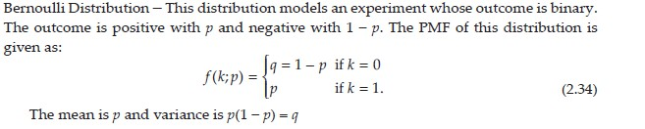
Multivariate Essential Mathematics
POISSON AND BERNOULLI DISTRIBUTION

Slide 22
POISSON AND BERNOULLI DISTRIBUTION
Bernoulli | Poisson
Only 2 outcomes | Many count outcomes
Event happened or not | How many times event happened
Example: Pass/Fail | Example: Number of calls
Used in classification | Used in event counting

Slide 23
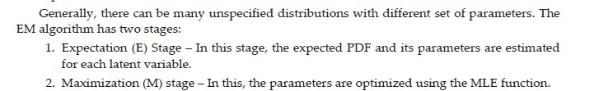
Density Estimation

Slide 24

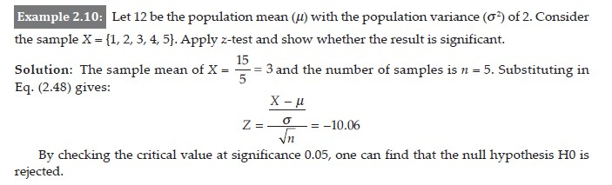
Hypothesis Testing
Z-TEST

Slide 25
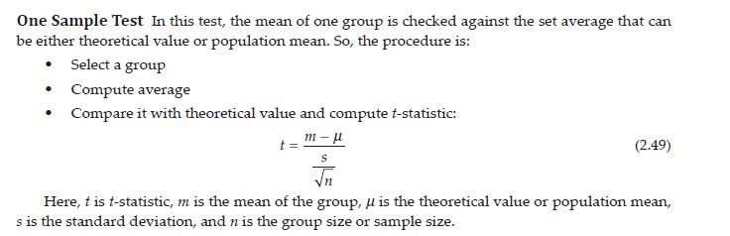
Hypothesis Testing
PAIRED T-TEST

Slide 26
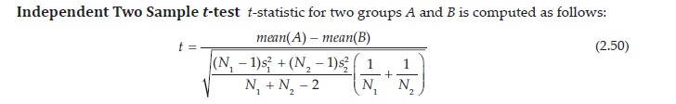
Hypothesis Testing
PAIRED T-TEST

Slide 27
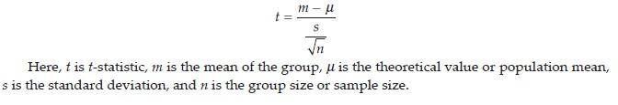
Hypothesis Testing
PAIRED T-TEST

Slide 28
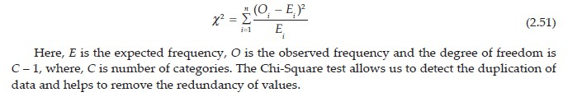
Hypothesis Testing
CHI-SQUARE TEST

Slide 29
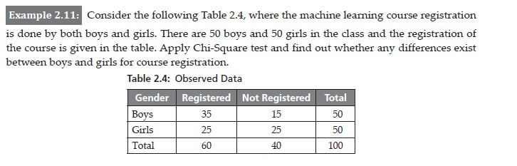
Hypothesis Testing
CHI-SQUARE TEST

Slide 30
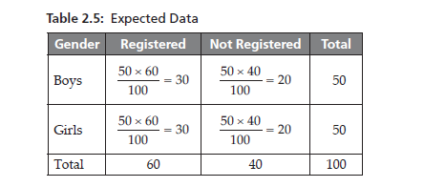
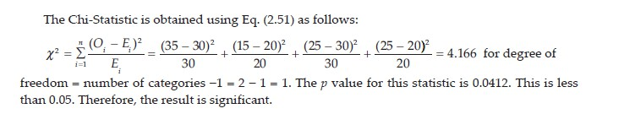
Hypothesis Testing
CHI-SQUARE TEST

Slide 31
Feature Engineering

Slide 32
Feature Engineering
Feature Engineering is one of the most important steps in Machine Learning.
It means preparing and improving the input data (features/columns) so that the model can understand patterns easily and give accurate predictions.
👉 In simple words:
Raw data is messy. Feature engineering converts it into “smart data” for the machine.

Slide 33
Feature Engineering
1.) Feature Transformation
2.) Feature Selection

Slide 34
Feature Engineering
1) Feature Transformation
This is about changing the form or scale of existing data without removing it.
We modify the feature so that the algorithm can learn better.
Why needed?
Different ML algorithms (SVM, KNN, Linear Regression) work properly only when data is in a proper format and similar scale.

Slide 35
Feature Engineering
Common Techniques
Normalization / Scaling
Standardization
  Mean becomes 0 and standard deviation becomes 1
Log Transformation
Encoding Categorical Data
Handling Missing Values

Slide 36
Feature Engineering
2.) Feature Selection
Here we choose only the important features and remove useless ones.
Not every column helps prediction. Some features:
create noise
slow training
reduce accuracy (overfitting)
So, we keep only relevant features.
Why important?
Too many features = Curse of Dimensionality
→ Model becomes confused.
Methods of Feature Selection
Filter Method
Wrapper Method
Embedded Method

Slide 37
Characteristics of Good Features
A good feature is one that actually helps the model make correct predictions.
During feature selection, we mainly remove features based on Relevancy and Redundancy.
FEATURES ARE REMOVED USING RELEVANCY:-A feature is relevant if it has a strong relationship with the target/output variable.
FEATURES ARE REMOVED BASED ON REDUNDANCY:-A feature is redundant if it gives the same information as another feature.

Slide 38

FEATURE SELECTION
FORWARD SELECTION:- Forward Selection is a wrapper method of feature selection.
It is used to choose the best subset of features step-by-step instead of using all columns.
Main idea:
We start with no features and keep adding only the useful ones.

Slide 39
How Forward Selection Works
Start with an empty set
Test each feature one by one
Select the best feature
Add the next best feature
Repeat the process
Stop condition

Slide 40
FEATURE SELECTION
BACKWARD SELECTION

Slide 41
Principal Component Analysis
Principal Component Analysis (PCA) is a data reduction (dimensionality reduction) technique used in statistics and Machine Learning.
It converts a large number of related variables (features) into a smaller number of new variables called Principal Components, while keeping maximum information (variance) of the data.
Why PCA is needed
In real datasets:
Many features are correlated (depend on each other)
More features ⇒ more complexity
More computation time
Overfitting in ML models
PCA helps to:
Remove redundancy
Reduce number of features
Speed up training
Improve visualization

Slide 42
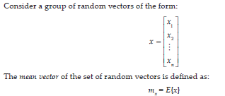
Principal Component Analysis

Slide 43
Principal Component Analysis
Compute Covariance matrix as
Compute Eigen values and Eigen vectors and matrix A as a set of eigen vectors

Slide 44

Principal Component Analysis
Compute PCA as
The original Data can be recovered as

Slide 45

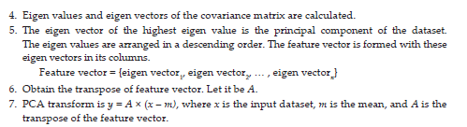

PCA Algorithm

Slide 46
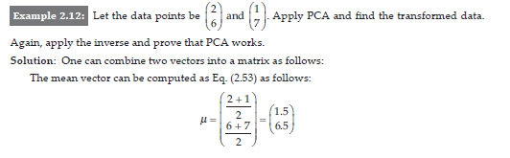
PCA Example

Slide 47
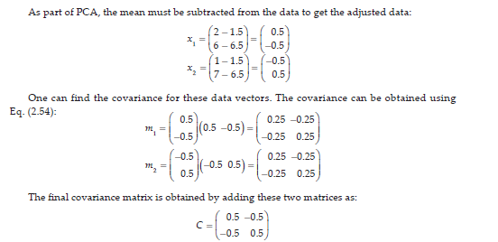
PCA Example

Slide 48
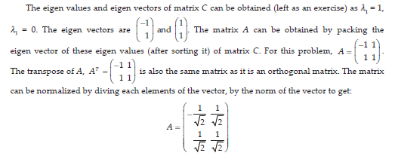
PCA Example

Slide 49

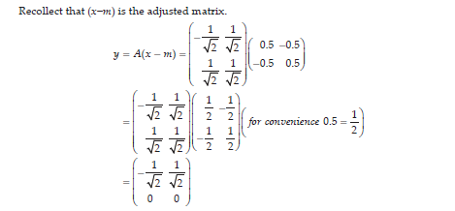
PCA Example

Slide 50
PCA Example

Slide 51
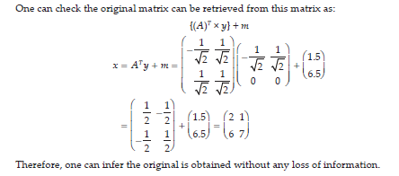
Verification

Slide 52


LDA Algorithm
Linear Discriminant Analysis (LDA) is a supervised dimensionality reduction and classification technique.
It reduces the number of features while keeping the classes (categories) clearly separated.

Slide 53
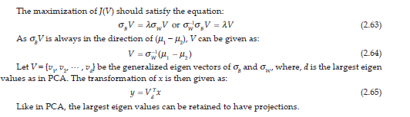
LDA Algorithm

Slide 54
LDA Algorithm
Why LDA is needed
In classification problems:
Data has many features
Some features overlap between classes
Classifier gets confused
LDA:
Reduces features
Improves class separability
Increases classification accuracy

Slide 55

SVD Algorithm
Singular Value Decomposition (SVD) is a matrix factorization technique used in Machine Learning, data compression, and recommendation systems.
It decomposes a large data matrix into smaller, meaningful matrices.

Slide 56
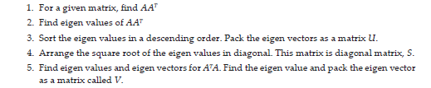
SVD Algorithm

Slide 57
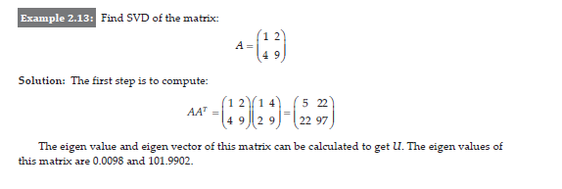
SVD Example

Slide 58
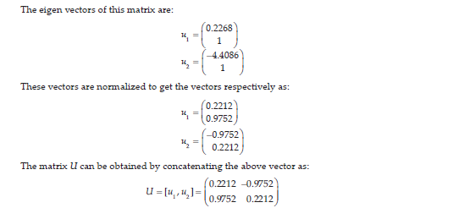
SVD Example

Slide 59
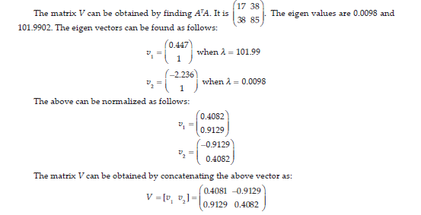
SVD Example

Slide 60

SVD Example

Slide 61
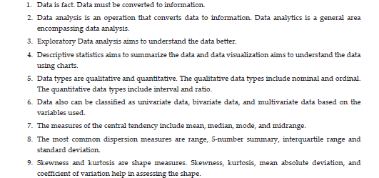
Summary

Slide 62
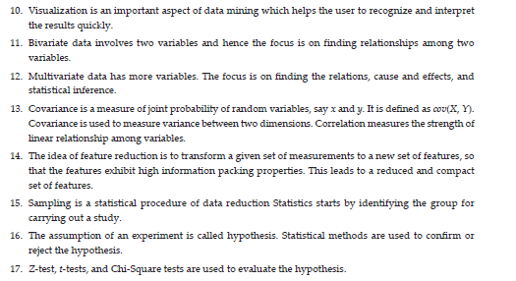
Summary

